Slide 2

Agenda
What makes conversations great?
Listening
Questioning & GROW
Practice time
The magic ingredients

Slide 3

What makes conversations great?

Slide 4

COACHING on many occasions is for a defined period of time and it focuses on a specific challenge. Coaches don’t need to have the skills and specific experience of the coachee, just the ability to create conversations to allow the coachee to articulate a challenge and provide a way of exploring options to resolve their challenge

Slide 5
THE SPECTRUM OF COACHING SKILLS
LISTENING TO UNDERSTAND
REFLECTING
PARAPHRASING
SUMMARISING
ASKING QUESTIONS THAT RAISE AWARENESS
GIVING FEEDBACK
MAKING SUGGESTIONS
OFFERING GUIDANCE
GIVING ADVICE
INSTRUCTING
MENTORING
COACHING

Slide 6

MENTORING enables an individual to follow in the path of an experienced colleague who can pass on knowledge, skills, experience and open doors to otherwise out-of-reach opportunities. Mentoring tends to be long-term and in fact many individuals continue to have mentors who remain mentors throughout their professional lives

Slide 7

Tell us about your greatest coaching conversation…

Slide 8

GREAT CONVERSATIONS PROS & CONS
CONS
Takes time at first
Sometimes people just want ‘the answer’
It assumes they have the answer
Not much good in an emergency!
Notes:
8

Slide 9
GREAT CONVERSATIONS PROS & CONS
PROS
Development of others
Increases capability to solve this and future challenges
Improved solutions and outcomes
Enhanced performance
Succession planning
The Monkey – not owning the problem
Time Saving (in the long run)
Notes:
9

Slide 10

WHAT WOULD BE DIFFERENT ABOUT AN ORGANISATION IF IT HAD SUCH A THING?
“For many business people, they hear that a coaching culture is a good idea, that it will improve morale, ensure talented people stay, and encourage the full realisation of the organisation’s long-term potential, but they don’t know exactly what it means.”
Alison Hardingham “The Coach’s Coach”

Slide 11

WHAT COULD A COACHING CULTURE DO?
Coaching will “what successful people do around here”
Leaders and employees speak openly
Goals, abilities, successes and failures will be discussed and agreed
Employees will be accountable for their activities
Coaching will be used to facilitate change
Barriers will be removed

Slide 12

WHERE DO YOU THINK YOU ARE?
Unconscious Incompetence
Conscious Incompetence
Conscious Competence
Unconscious Competence

Slide 13
BEAR IN MIND … SKILL VS. WILL OF THE PERSON YOU ARE COACHING
High
WILLING
Don’t know
they need it
WILLING
Know they
need it
If they know they need it it will be an easier conversation
Willingness
to be supported
UNWILLING
Don’t know
they need it
UNWILLING
Know they
need it
Low
High
Awareness of need to be supported
“Performer” Driven
“Influencer” Driven

Slide 14

INGREDIENTS FOR GREAT COACHING CONVERSATIONS……
ACTIVE LISTENING
QUESTIONING
GROW
THE MAGIC INGREDIENT

Slide 15
Listening

Slide 16

MIRROR & MATCH
We unconsciously look for similarities in our environment / others. Being similar (not the same) can enable rapport building

Slide 17
MIRROR & MATCH
Body
Voice
Language
Posture
Facial expressions
Hand movements
Eye movements
Breathing
Feet movements
Body shifts
Spine angle
Head angle
Volume
Tone
Pitch
Tempo
Key words
Common experience

Slide 18

TOP TIPS FOR BEING IN THE MOMENT
Suspend all judgement
Focus your energy on the person
Create the right environment
Minimise any distractions
Good will and good intent
Listening is like a muscle – it’s something you need to exercise

Slide 19

How do you think this may be different when working virtually?

Slide 20
Questioning & GROW

Slide 21
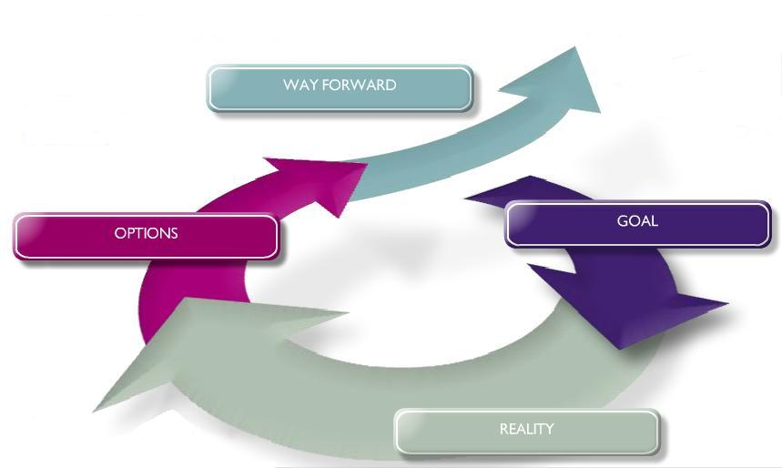
THE G.R.O.W. MODEL

Slide 22
G.R.O.W. QUESTIONS
GOAL
What is the outcome you want?
How will you know that you have achieved that goal?
When, where and with whom do you want this outcome?
What outcome do you want from this session?
Describe to me what you would like to happen

Slide 23
G.R.O.W. QUESTIONS
REALITY
What is happening now?
What have you done already? What has been the effect?
How much control do you have of the situation?
What obstacles are in the way do you achieving this??
What assumptions are you making regarding the current situation?

Slide 24
G.R.O.W. QUESTIONS
OPTIONS
What options have you considered?
What will happen if the constraints are removed?
What criteria will you use to weigh up the options?
Which solution most appeals to you?
What are the benefits and downsides of each option?

Slide 25
G.R.O.W. QUESTIONS
WAY FORWARD
What will you do now?
When will you do it?
What could stop you moving forward? How will you overcome any obstacles?
What support will you need?
How committed are you to this course of action on a scale of 1 to 10?
How could you make it a 10?

Slide 26

CLARIFYING THE APPROPRIATE OUTCOME
If the individual doesn’t open up you may need to lead them to the performance issue you want to address therefore your style may become more directive. Make sure you get agreement before you start to use the GROW model to expand and address the issues
PERFORMANCE SPECIFIC
How has this year been for you?
What have been your key successes and what have been your key challenges?
How are you feeling about your performance?

Slide 27

CLARIFYING THE APPROPRIATE OUTCOME
CAREER DEVELOPMENT SPECIFIC
What are your career aspirations?
Where do you see yourself in two year’s time?
What is it that you are trying to achieve from your career in the short and long term?
What do you really enjoy doing and what do you feel are your strengths?
What would success look like as an outcome of this conversation for you?

Slide 28

GIVING FEEDBACK
What worked?
Where did you get stuck?
What would you do differently next time?

Slide 29

So, what did you learn?

Slide 30

WHAT TO AVOID
Explaining instead of listening – explore not fix
Repeating your views when you meet resistance – try to see the world through the other person’s eyes
Advising before understanding – suspend your agenda and listen and concentrate
Giving the answer
Preaching e.g. your view on how people should behave, how a job should be done

Slide 31
So, what did you learn this time?

Slide 32
Summary

Slide 33

SUMMARY…
Great conversations aren’t always formal, pre-planned meetings
It isn’t always about the GROW model – sometimes it’s just a few great questions that help the person think about their situation differently and release more ideas
Great conversations should provide supportive relationships
Coaching techniques can be applied to any great conversation e.g. career, performance, specific challenges, engagement etc
It takes practice!

Slide 34
The magic ingredients!

Slide 35
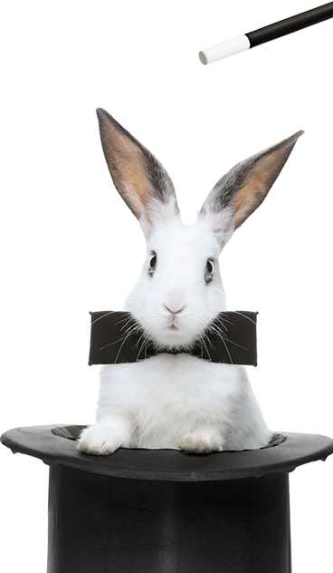
THE MAGIC INGREDIENTS!
Have good will and good intent
Show consistency between your words and actions by making realistic commitments and demonstrating follow through to others
Be predictable by letting people know what to expect from you
Listen- be in the moment!
Be willing to admit when you have made a mistake
Challenge yourself – be authentic
Seek feedback

Slide 36
Any questions?

Slide 37
Goodbye, thank you & good luck!

